Slide 1
Solving the Maze by Depth-First Traversal
Linh Bien

Slide 2
Table of content
Introduction
Design
Implementation
Test
Enhancement ideas
Conclusion
References

Slide 3
Introduction
In this project, we need to solve the problem whether we can go from the start position to the destination position in the Maze (clear route and unclear route).
The proposed solution is to apply Depth First Search.
The solution will be explained and tested in some examples with diagram and programming.

Slide 4
Design
Problem: Find the way to go from the start position to the destination position in a Maze. There are two cases: imagine when a robot without wheel goes in a clear route and a robot with wheel goes in unclear route.
Robot | Clear route (street, highway) | Unclear route(hospital,hotel)
Without wheel (legged robot) | Tree (example 1)
With wheel(self driving car) |  | Matrix (example 2)

Slide 5
Design
Solution:
We can use Depth First Search or Breadth First Search.
Depth First Search (DFS) is algorithm traverses a graph in a depthward motion. Depth First Search uses stack to remember to get the next vertex to start a search while the Breadth First Search uses queue.
Since the robot is the embedded system and memory is important, compare two solutions, Depth First Search is a better solution for the benefit of less memory space and less time if go to the right path.

Slide 6
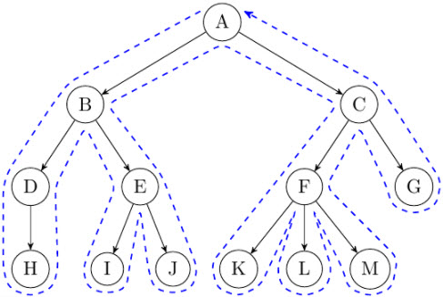
Design
Rule 1
Visit the adjacent unvisited vertex.
If there are several vertices, randomly pick one.
Mark it as visited.
Display it.
Push it in a stack.
Rule 2
If no adjacent vertex is found, pop up a vertex from the stack.
It will pop up all the vertices from the stack, which do not have adjacent vertices.
Rule 3
Repeat Rule 1 and Rule 2 until the stack is empty.

Slide 7
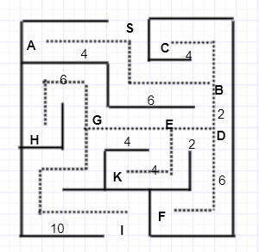
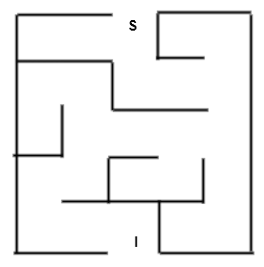
Example 1
Given a Maze: Return True if can go from start S to destination I. If not, return False

Slide 8
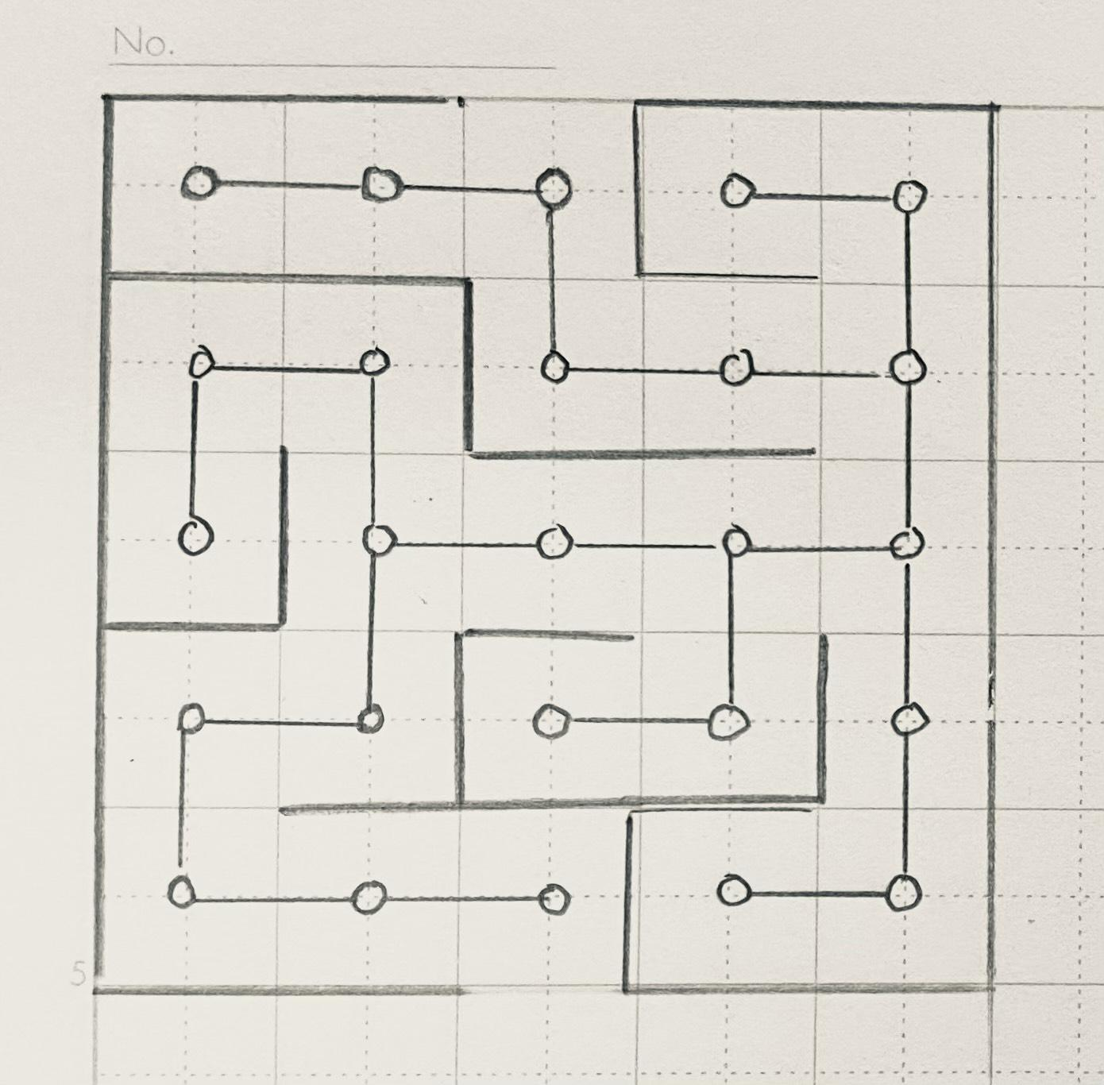
Step 1 & 2

Slide 9
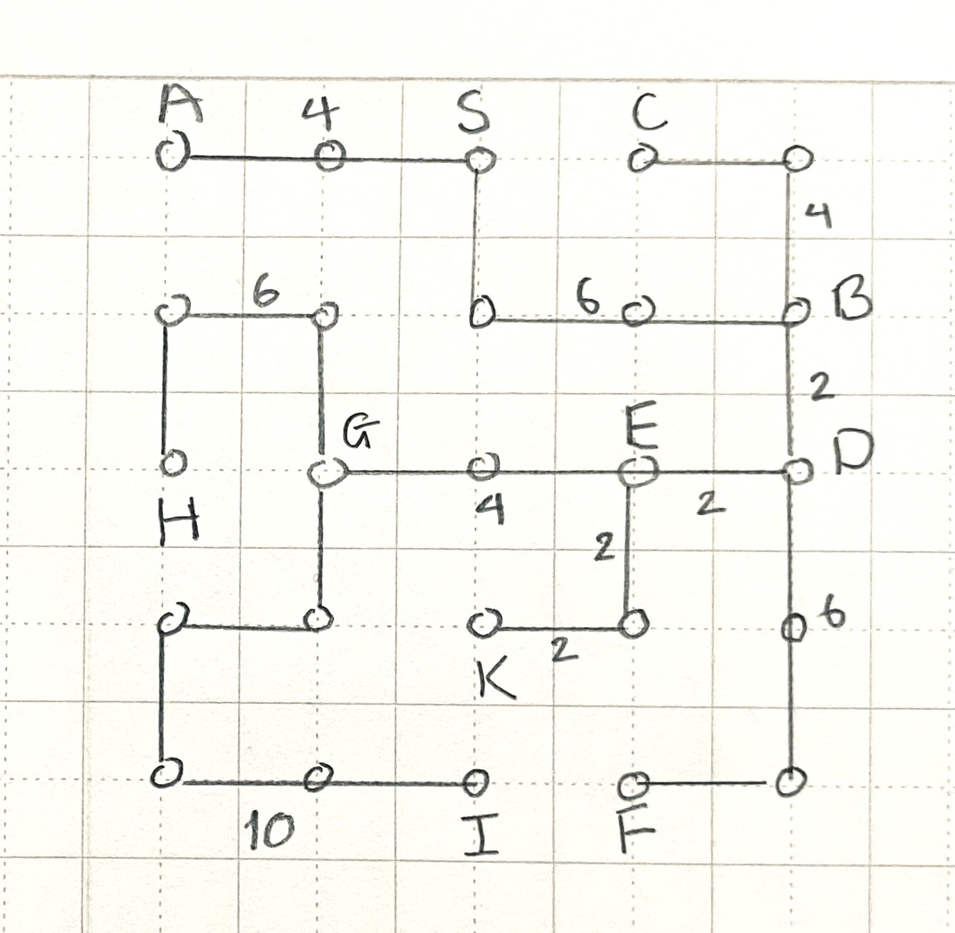
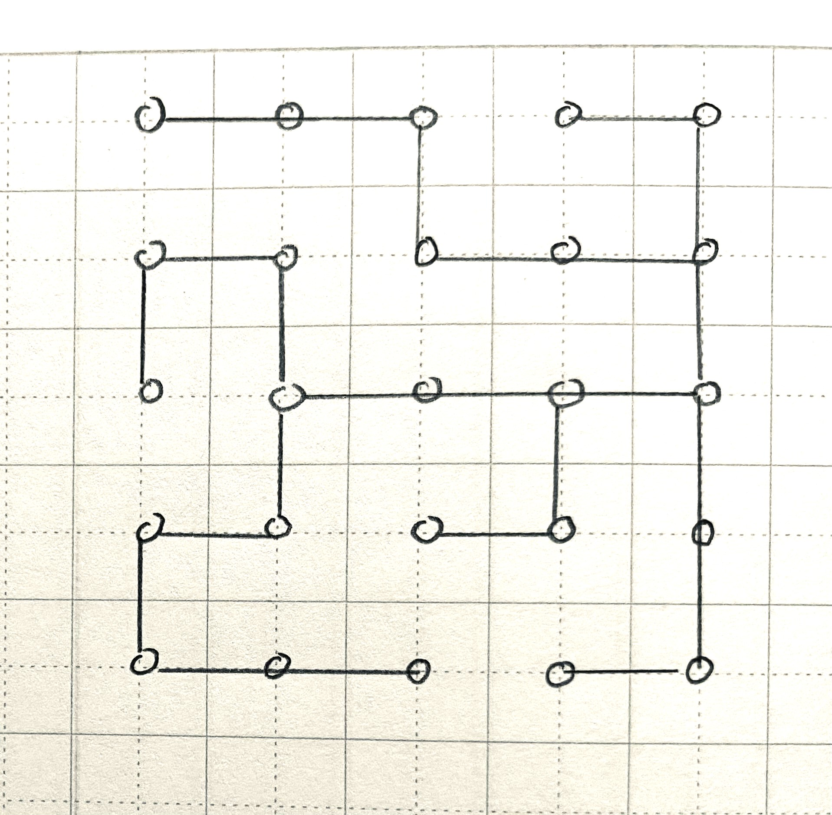
Step 3 & 4

Slide 10
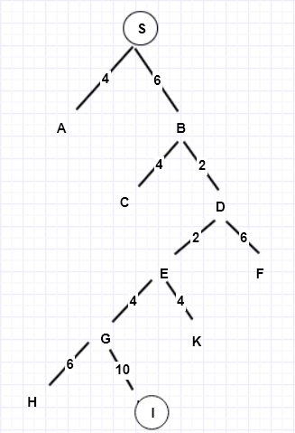
Example 1
Let’s view in form of a tree. S is the node and 2 branches: right, left. Apply DFS
From S we can go to A or B. A is dead end. Go to S, B
From B we can go to C or D. C is dead end. Go to B, D
From D we can go to E or F. Go to E
From E we can go to G or K. Go to G
From G we can go to H or I. H is not destination. Go to G, I. I is the destination.
S -> B -> D -> E -> G -> I : True
Distance: 24 units. Save time than BFS

Slide 11
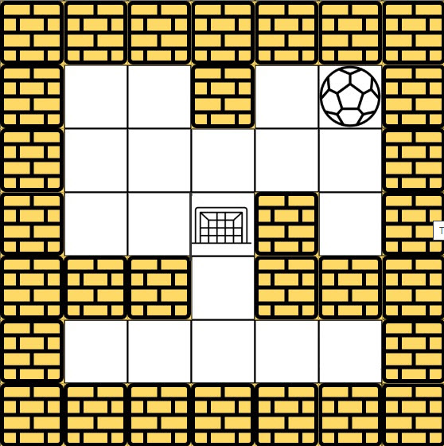
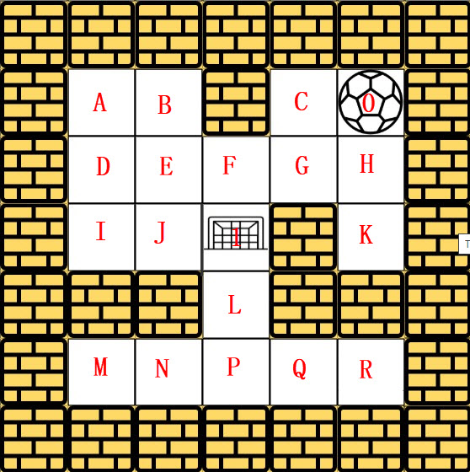
Example 2
Conduct Depth_First Traversal - Right, Left, Up, Down

Slide 12
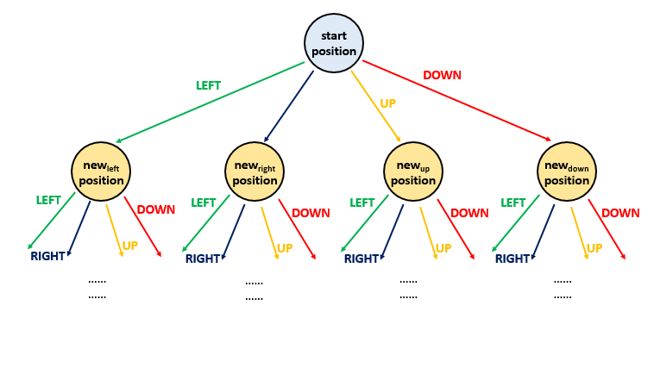
Example 2
Let’s view the given search space in a form of a tree:
Starting position: the root node of the tree
Right, left, up or down: 4 different routes, 4 branches
The new node reached from the root traversing over the branch represents the new position occupied by the ball after choosing the corresponding direction of travel

Slide 13
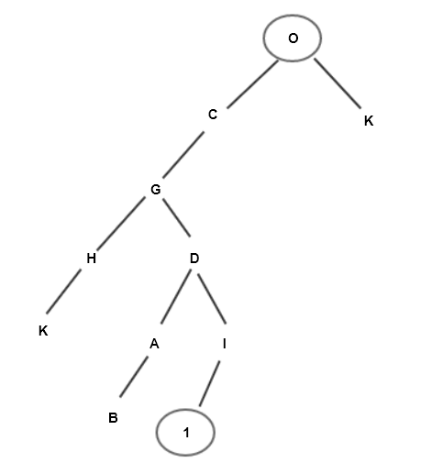
Example 2
In a tree: 0 is the node, 4 branches: right, left, up, down. Appy DFS:
From 0 can go to C ( or K ). Go to C
From C can go to G
From G can go to D or H. Go to H
From H can go to K ( K is dead end). Go back to G -> D
From D can go to A or I (other points are visited)
From A can go to B (B is dead end). Go back to A ->D -> I
From I can go to 1: destination. True
-> Same time, less memory space than BFS

Slide 14
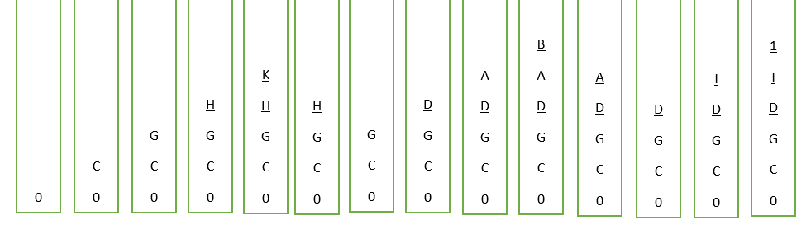
Example 2
Use stack:

Slide 15

Implementation
Implement Depth First Search
on Python 3

Slide 16
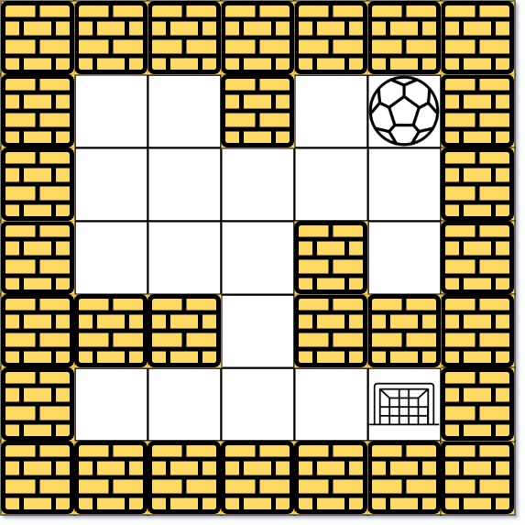
490. The Maze ( Leetcode)
Description:
There is a ball in a maze with empty spaces (represented as 0) and walls (represented as 1). The ball can go through the empty spaces by rolling up, down, left or right, but it won't stop rolling until hitting a wall. When the ball stops, it could choose the next direction.
Given the m x n maze, the ball's start position and the destination, where start = [startrow, startcol] and destination = [destinationrow, destinationcol], return true if the ball can stop at the destination, otherwise return false.
You may assume that the borders of the maze are all walls

Slide 17
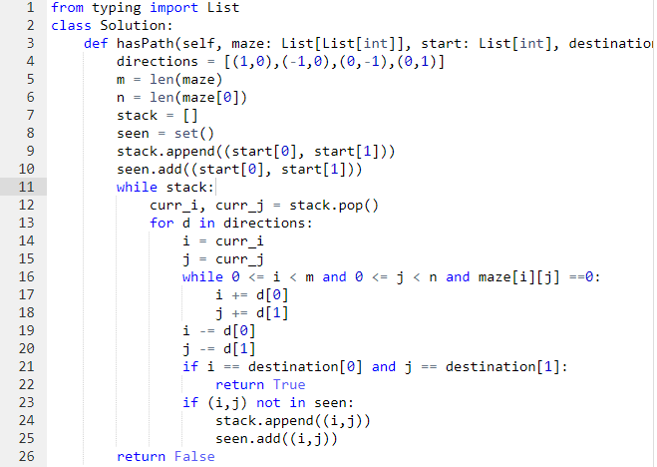
Programming

Slide 18
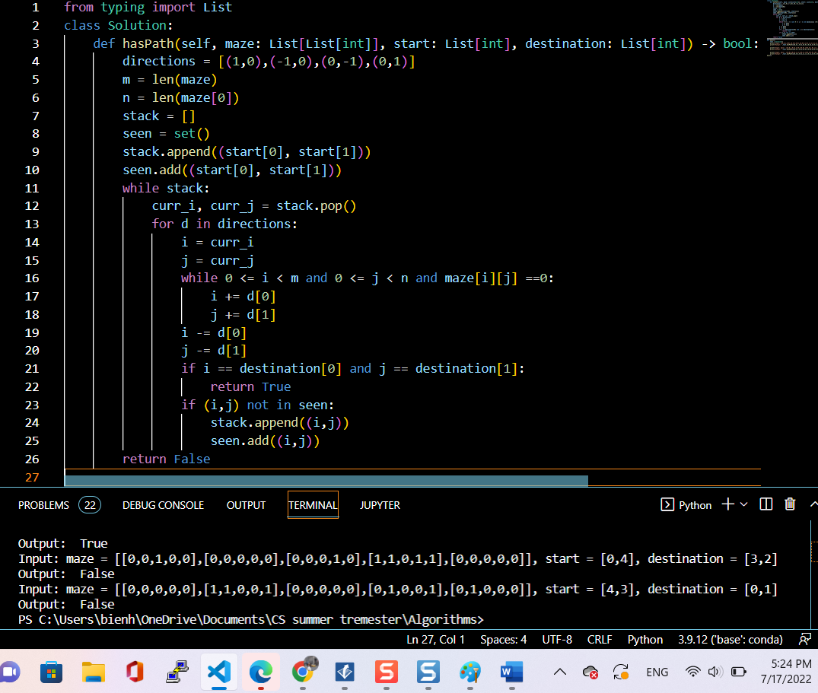

Slide 19
Test
def main():
test = Solution()
print("Input: [[0,0,1,0,0],[0,0,0,0,0],[0,0,0,1,0],[1,1,0,1,1],[0,0,0,0,0]], start = [0,4], destination = [4,4]")
print("Output: ",test.hasPath([[0,0,1,0,0],[0,0,0,0,0],[0,0,0,1,0],[1,1,0,1,1],[0,0,0,0,0]],[0,4],[4,4]))
print("Input: maze = [[0,0,1,0,0],[0,0,0,0,0],[0,0,0,1,0],[1,1,0,1,1],[0,0,0,0,0]], start = [0,4], destination = [3,2]")
print("Output: ",test.hasPath([[0,0,1,0,0],[0,0,0,0,0],[0,0,0,1,0],[1,1,0,1,1],[0,0,0,0,0]], [0,4],[3,2]))
print("Input: maze = [[0,0,0,0,0],[1,1,0,0,1],[0,0,0,0,0],[0,1,0,0,1],[0,1,0,0,0]], start = [4,3], destination = [0,1]")
print("Output: ",test.hasPath([[0,0,0,0,0],[1,1,0,0,1],[0,0,0,0,0],[0,1,0,0,1],[0,1,0,0,0]],[4,3],[0,1]))
main()

Slide 20
Output
Input: [[0,0,1,0,0],[0,0,0,0,0],[0,0,0,1,0],[1,1,0,1,1],[0,0,0,0,0]], start = [0,4], destination = [4,4]
Output: True
Input: maze = [[0,0,1,0,0],[0,0,0,0,0],[0,0,0,1,0],[1,1,0,1,1],[0,0,0,0,0]], start = [0,4], destination = [3,2]
Output: False
Input: maze = [[0,0,0,0,0],[1,1,0,0,1],[0,0,0,0,0],[0,1,0,0,1],[0,1,0,0,0]], start = [4,3], destination = [0,1]
Output: False

Slide 21
Enhancement ideas
Breadth First Search (BFS) can be another solution. Queue will be used instead of stack.

Slide 22
Conclusion
To solve the Maze problem, we imagine two cases: Case 1: a robot without wheel goes in a clear route. Case 2: a robot with wheel goes in unclear route.
We can view the given space search in a form of a tree with node as the start position and branches are all the different options ( 2 options: right, left for case 1 or 4 options: right, left, up, down for case 2 ).
Depth - first search (DFS) is useful in cycle detection in graphs such as maze, consumes less memory space and will reach at the goal node in a less time if it traverses in a right path.

Slide 23
References
Karleigh M, Ken J, Jimin K, Depth-First Search (DFS). Retrieved 07/18/2022 from https://brilliant.org/wiki/depth-first-search-dfs/#complexity-of-depth-first-search
Tutorialspoint. Data Structure - Depth First Search. https://www.tutorialspoint.com/data_structures_algorithms/depth_first_traversal.htm

